Slide 1

Facebook Data Analysis Presented By Saranya Dass

Slide 2

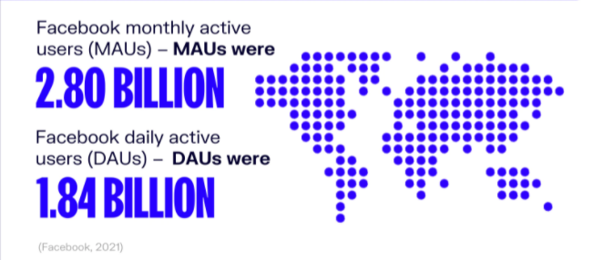

Facebook, Inc. is an American social media conglomerate founded in 2005 by Mark Zuckerberg with 2 other classmates from Harvard University.

Slide 3

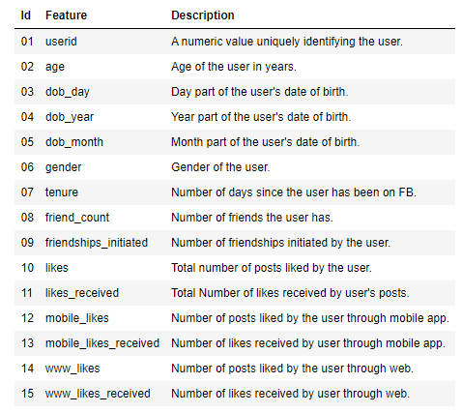
Problem Statement
Data Description
The company wants to increase the opportunity for users to use Facebook for social media campaigns, for small and big businesses and also enable users to generate effective leads.
Improve the user experience on the web and its mobile app.
To understand usage patterns and the age group that is most active and popular on facebook.
How the friendships initiated and the total friend count vary with gender , tenure etc.

Slide 4
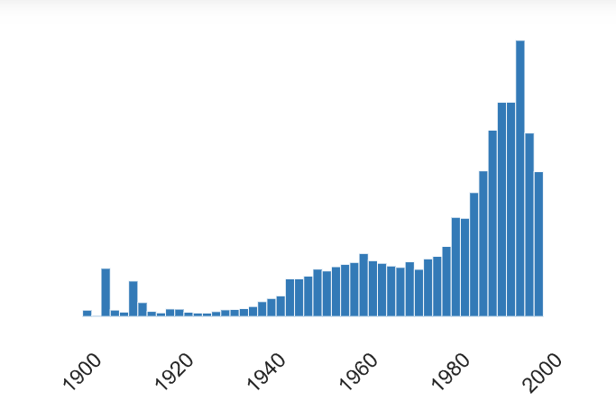
Insights Derived from Pre - Profiling
Minimum age is 13 and maximum age is 113.
The number of males in the data set is higher than the number of females.
The mean tenure is around 537 days.
The number of friends vary drastically with a maximum of 4923 friends.
The number of friendships initiated has a mean value of 107, but the graph is again very skewed.
The number of mobile likes received seem to be significantly higher than the www likes indicating more app usage.
Spread of Birth year in the data set.

Slide 5

Data Cleaning

Slide 6
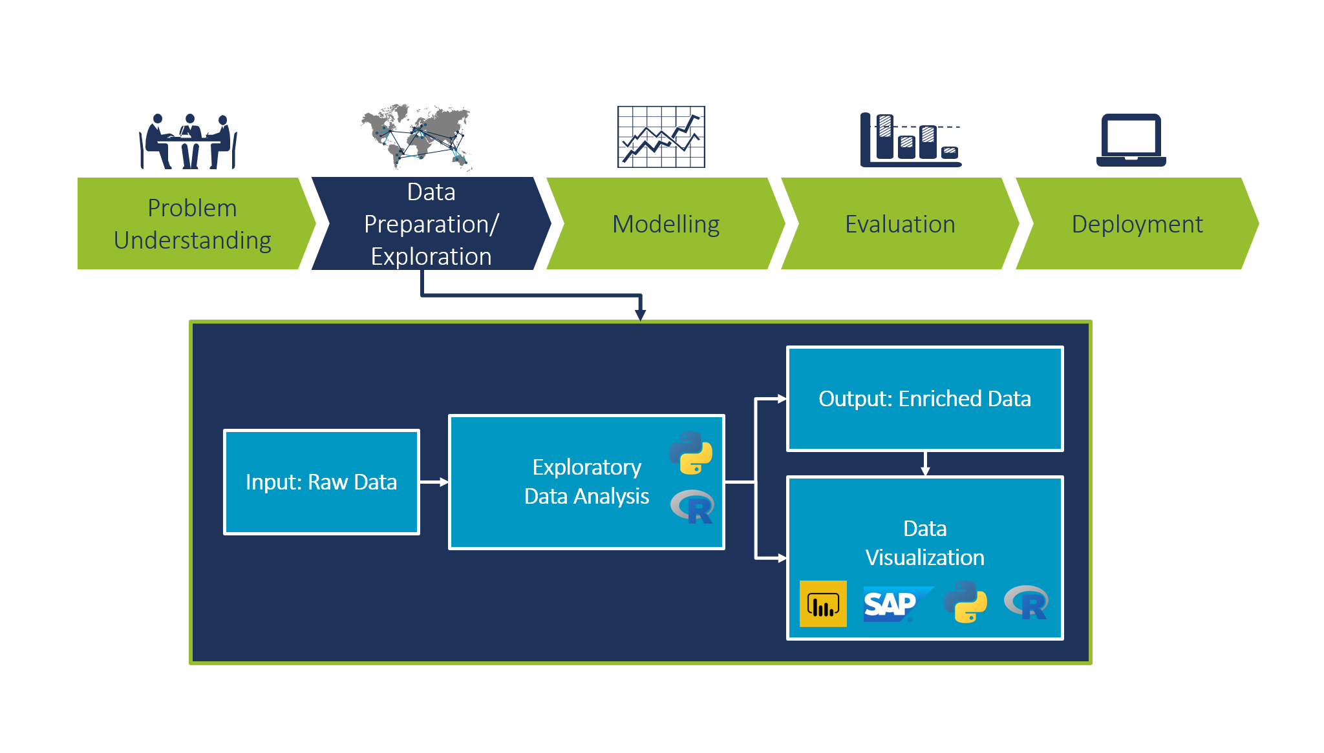
Exploratory Data Analysis

Slide 7
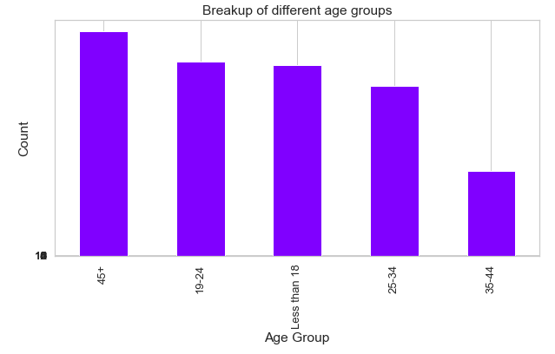
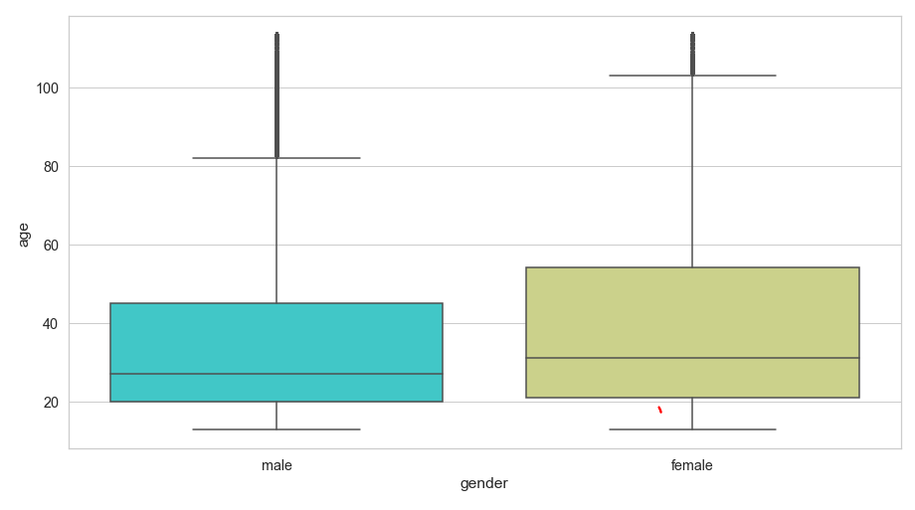
Preliminary Analysis
Highest and Lowest age group in the data set and their counts.
113 and 13
Spread of age group for male and female.
Adding one more column called age group

Slide 8
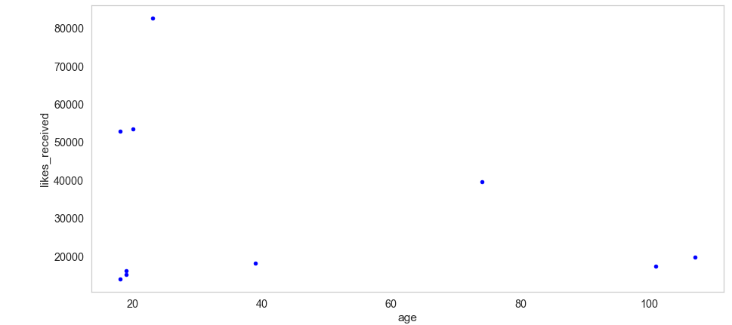
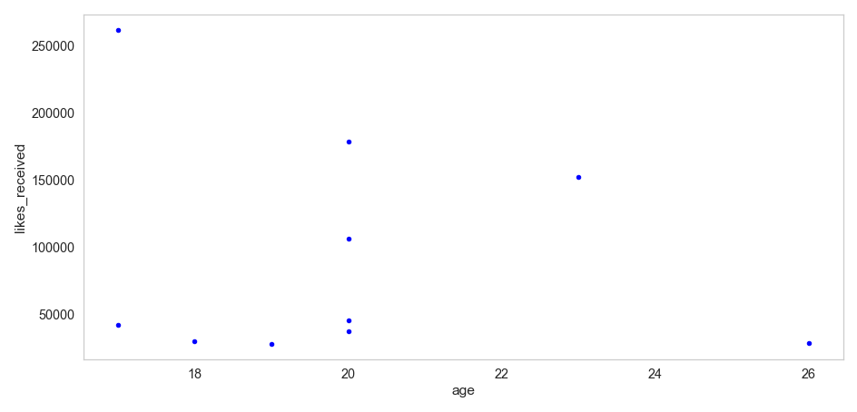
Analysis Based on Likes Recieved
Males in the age group of 18-24 are the most popular with a substantially high number of likes received, while for females the spread is between 11 to 20 years.

Slide 9
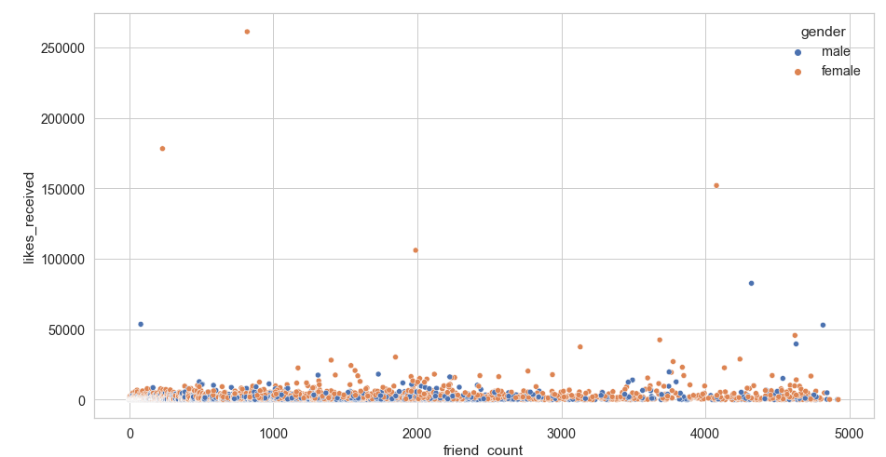
Relationship Between Friend Count and Likes Received
There is no relationship between friend count and likes received.
As the friend count increases there seems to be a slight uphill trend.
There are a few outliers at >250000 likes for a lesser friend count.
These are probably social media influencers , bloggers, or any other celebrity figure.

Slide 10
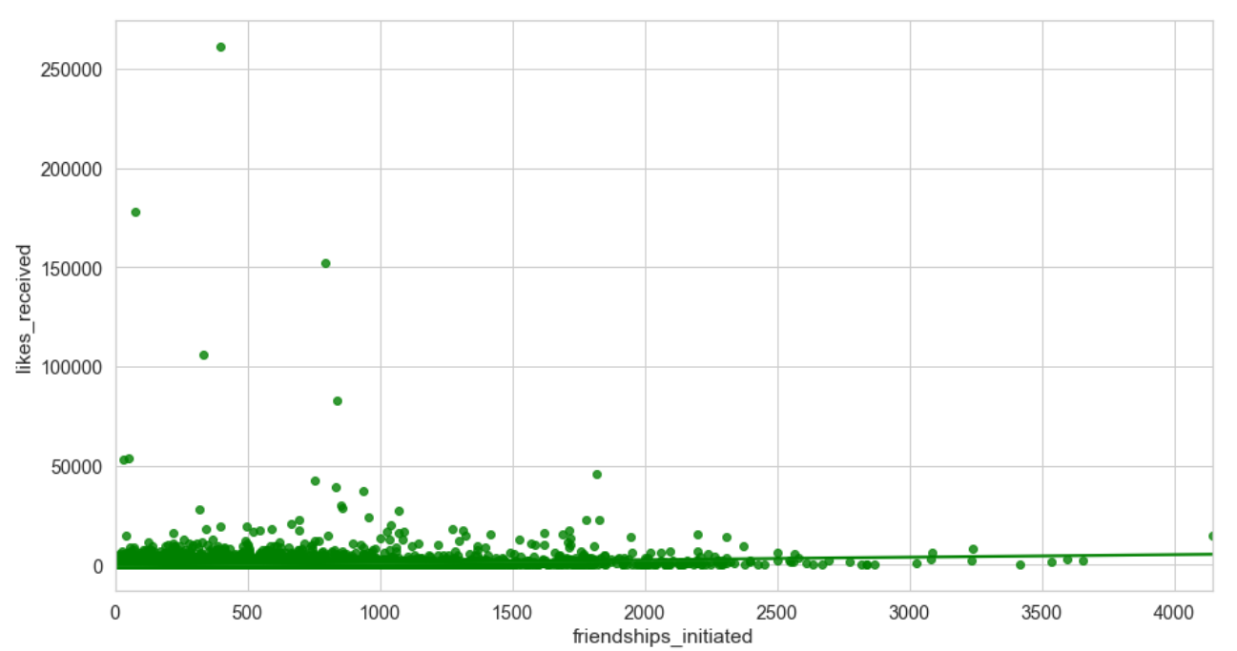
Relationship between likes received and friendships initiated
For Friendships initiated of less than 1000 , the number of likes received is high.
However, it keeps decreasing with a very high number of friendships initiated.

Slide 11
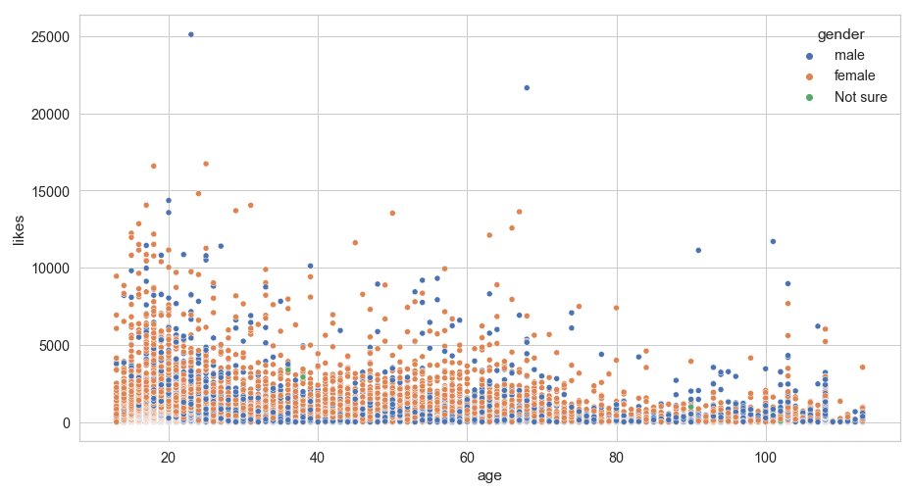
Age and gender Vs Likes Received
Younger females and males seem to receive a higher number of likes than the rest.
This implies that facebook should start tracking posts created by this age group, in order to understand the pattern and be able to promote certain posts.
Segregating these user accounts into social media bloggers, vlogs, influencers, entrepreneurs , small business holders etc, will help trace the usage pattern at a more granular level.

Slide 12
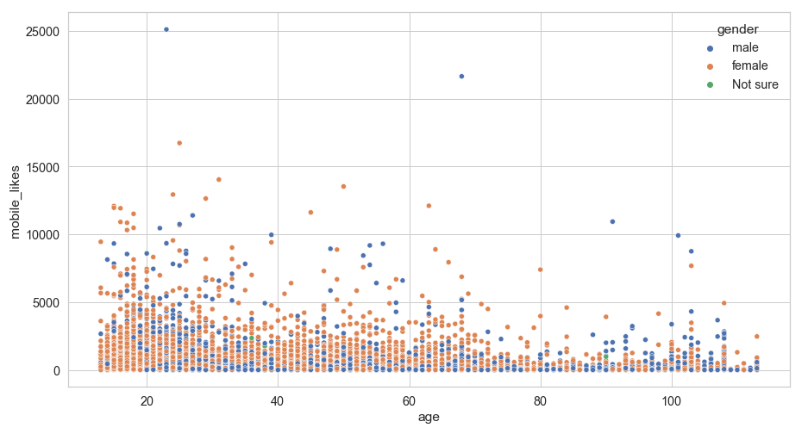
Relationship between age and likes given through mobile application .
People in the age group between 20 and 30 have the maximum likes given through mobile access.
With increase in Age, the number of likes given through mobile keeps reducing steadily.

Slide 13
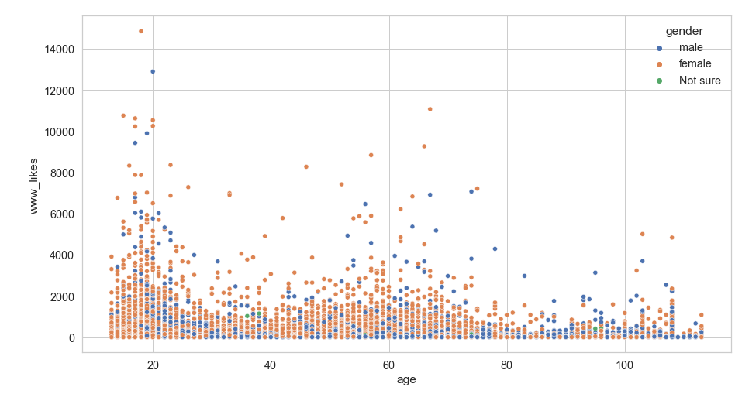
Relationship between age and likes given through web page.
People in the age group between 18 and 24 have the maximum likes given through web access and females seem to be more addicted.
The number of likes given through web access keeps reducing , with a spike near 70 years of age.

Slide 14
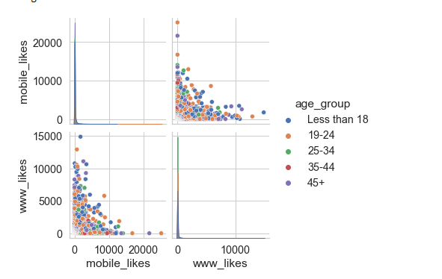
Relationship between usage through mobile application and web page.
There is a negative relationship between www likes and mobile likes given. This indicates that most individuals access Facebook using only one device.
Hence we should track the web usage and mobile app usage separately and target these group of users at a more granular level.

Slide 15
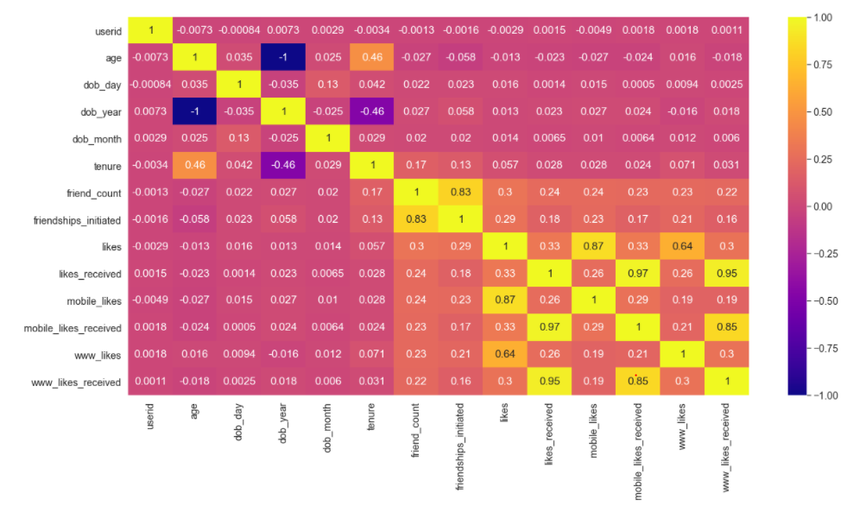
Corelation Between Multiple Continuous Variables
Analysis:
There is a high corelation between friend count and friendships initiated.
There is a high corelation between mobile likes given and total number of likes given, and low corelation between the www likes given and the total likes given.
There is a high corelation between mobile likes received and total number of likes received, which is slightly greater than the corelation between www likes received and total likes received.

Slide 16

Actionable Insights and Suggestions
The spread of data for females is between 20 and 55 years of age and for males it is between 20 to 45 years of age.
Younger males seem to be more engaged hence further analysis can be done to identify their behavioural patterns and the content they engage with , implying higher social media presence.
Popular males and females belonging to a certain age group ( 18-22 ) approximately have the highest number of likes received. Hence , closely analysing their social media presence with time of the day, the different pages they have created, their personalities etc can be tracked and social media analytics can play a vital role in it.
Usage of mobile device to access Facebook is high for people in the age group of 18 to 30. However, for
high number of likes given through the web, seems to be spread till the age of 65-70 years.
In order to encourage users to interact with Facebook more for social media marketing, it is important to
gather further data on small and large business pages on Facebook and how different individuals are leveraging Facebook for it.

Slide 17
Conclusion
Through EDA and associated visualizations we realized that the age group which uses Facebook more actively is between 20- 30 years of age and they use the mobile app more frequently.
Web usage however is spread over a wider age group implying that social media features on the website are more user friendly, easy to use and interactive.
Further analysis can be conducted to identify the different pages they visit , the businesses they have setup and are active on, and also how social media campaigns have gathered pace over the last few years.
This will help Facebook improve their user base and also help achieve the target of increasing Facebook usage commercially.

Slide 18
Thank You

